Slide 1

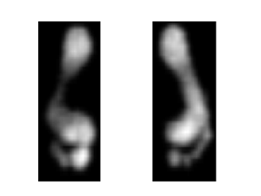
Deep learning in Time series Classification
Saeed Kazemi

Slide 2
Presentation Contents
The problem and Dataset
Feature Extraction and Selection
Deep Learning Algorithm
Machine Learning Algorithm
Results and Discussion

Slide 3
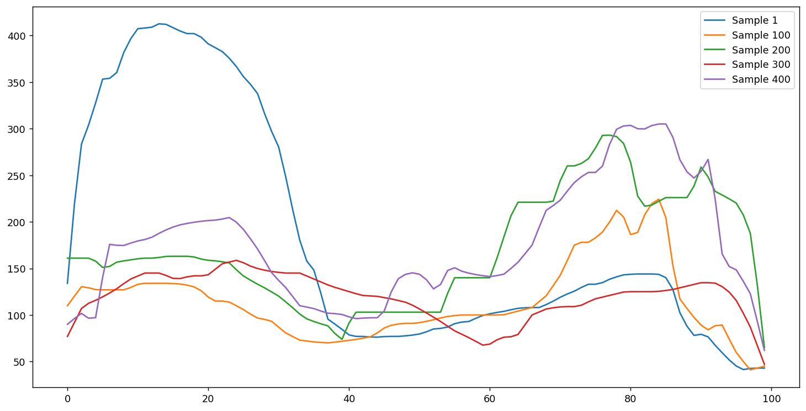
Describing the problem
Classification on time series data

Slide 4
The Dataset
Stepscan datasets was used in this project
Stepscan dataset is a video-based dataset.
Obtained from high resolution floor tiles.
1744 Samples * 200 frames * (80 * 60) images
80 subjects
Each subject has approx. 20 samples
Verification mode was used for this research.

Slide 5
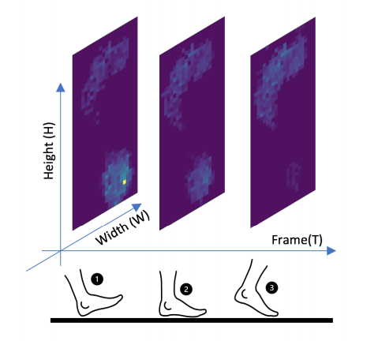
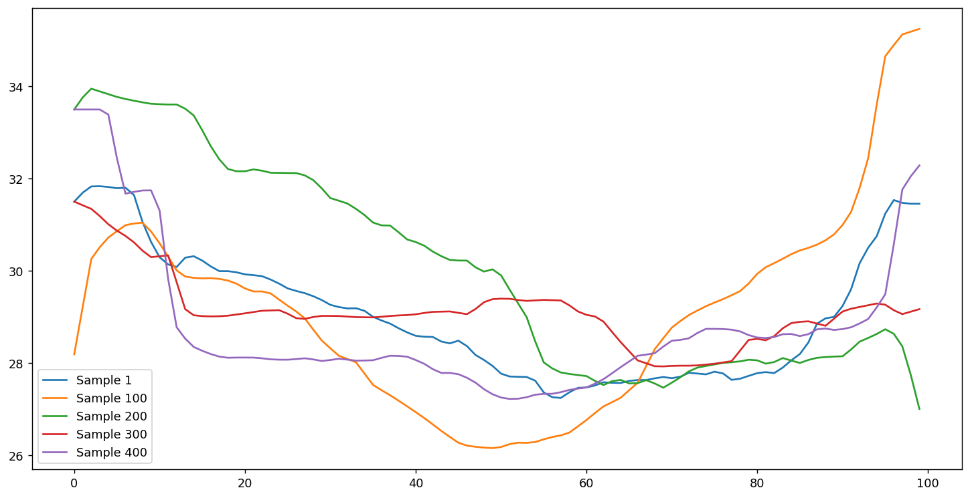
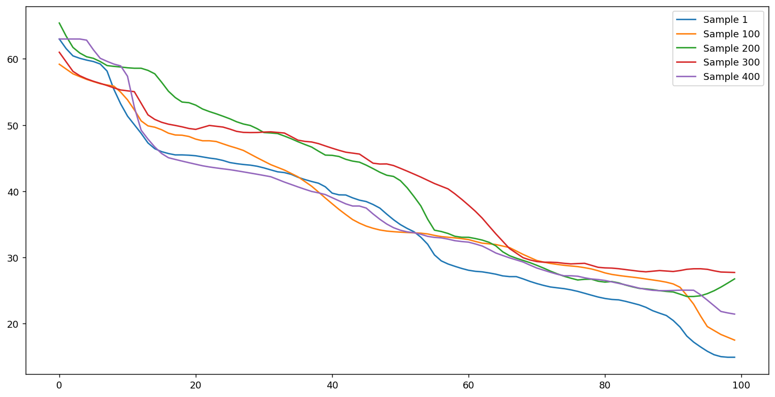
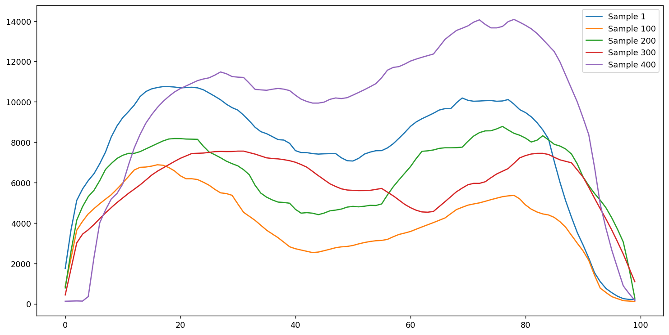
convert a video data to time series.
Extracting 4 features from each frame
Track those features in each frame
Achieving four 2D time series

Slide 6
Feature Extraction and Selection
Two different approaches were used for feature extraction:
Handcrafted features
Extraction of 4 groups of features
Autoregressive coefficients Features
Temporal Features
Spectral Features
Statistical Features
low variance and high-correlated features were deleted
Deep learning features
Used pre-trained CNN to extract features automatically

Slide 7
Machine Learning Approaches
Implemented several (LDA, KNN, SVM, RFC)
20% percent of samples were set aside for testing the classifier,
The rest was divided into 10-fold cross-validation for evaluation and training.
The grid search were implemented to find the best hyper-parameters.
knnspace = {
"model__n_neighbors": np.arange(1, 22, 2),
"model__metric": ["euclidean", "manhattan", "chebyshev"],
"model__weights": ["distance", "uniform"],
"sfs__k_features": [100, 200, 300]}
svmspace = {
"model__probability": [True],
"model__kernel": ["rbf", "linear"],
"model__decision_function_shape": ["ovr", "ovo"],
"model__C": [0.1, 10, 1000],
"model__gamma": [1, 0.01, 0.0001],
"model__random_state": [seed],
"sfs__k_features": [100, 200, 300]}
treespace = {
"model__max_depth": np.arange(3, 33, 2),
"model__criterion": ["gini", "entropy"],
"sfs__k_features": [100, 200, 300]}

Slide 8
Deep learning algorithms
“Hand crafting” features requires domain knowledge
Deep learning uses nested neural networks to automatically learn what aspects of the data are important
There are many architectures for time series deep learning:
LSTM
CNN-LSTM
ConvLSTM
Fully Convolutional Networks (FCN)
Echo State Networks (ESN)
Most architectures are used for time series data
 | Machine learning | Deep learning
Size of raining data set | Small | Large
Feature Extraction | Yes | No
Debugging | Easy | Hard
Training Time | Short | long

Slide 9
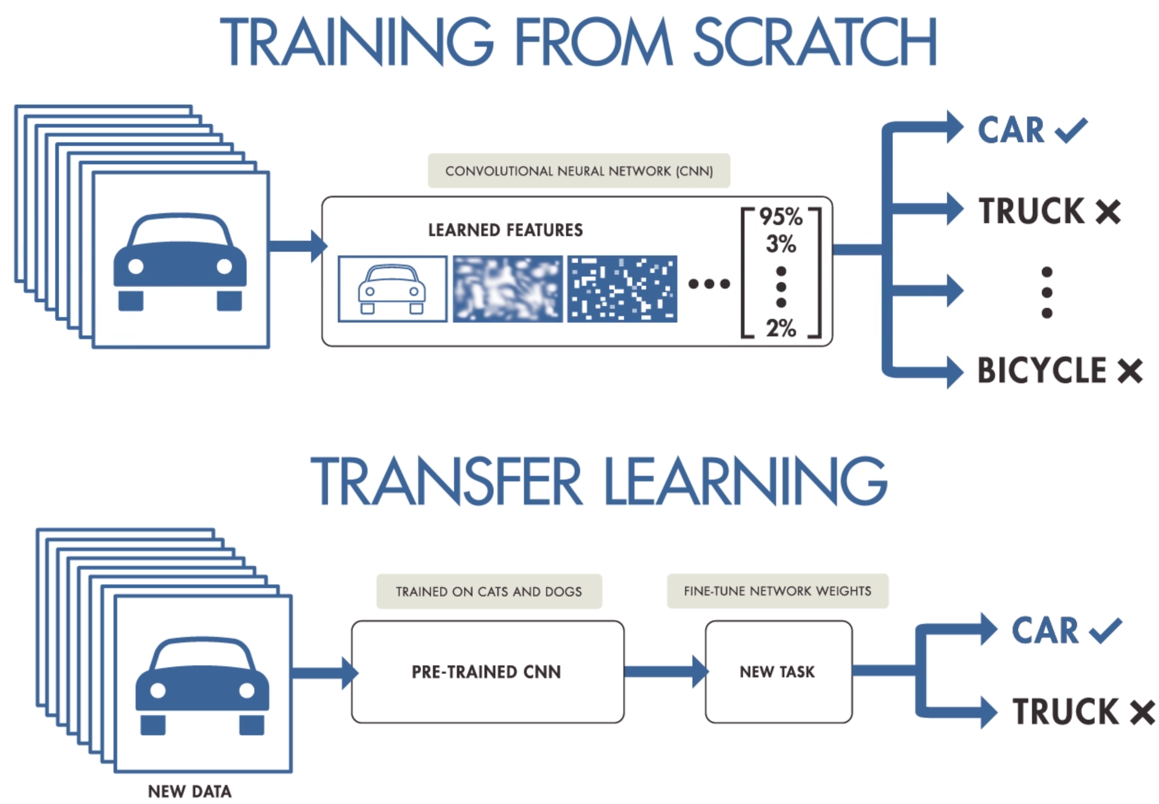
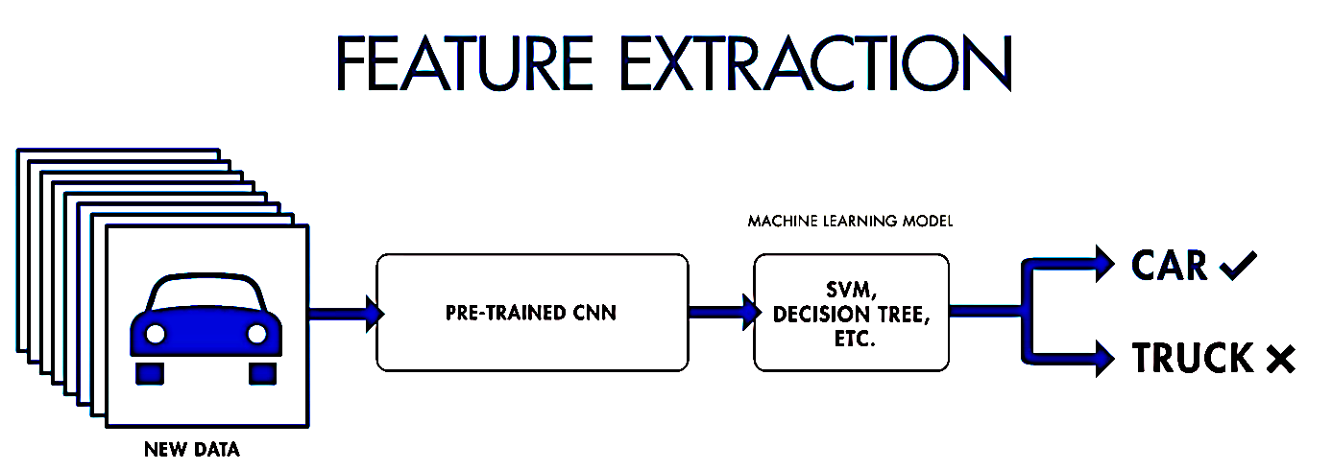
Deep learning algorithms
1
2
3

Slide 10
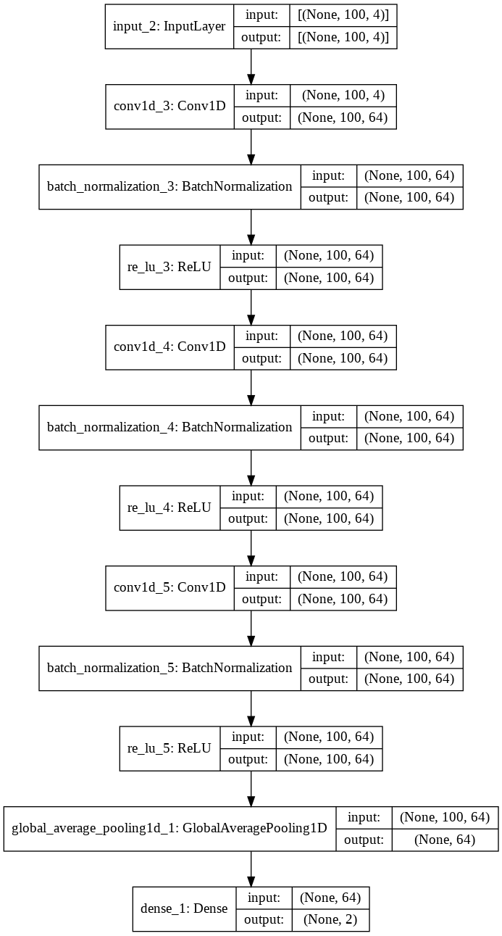
end-to-end method
We also implemented DNNs as end-to-end networks (FCN)
This network has three blocks.
Each block is a convolutional layer followed by a batch normalization and a ReLU activation layer.
Hyper-parameters:
epochs = 200
batch_size = 32
optimizer="adam”
loss="sparse_categorical_crossentropy"
Trainable params: 26,050

Slide 11
Transfer learning method
Implemented LDA, kNN, SVM, and RFC.
We used Ricker wavelet (“Mexican hat wavelet”).
Compared 2 CNN architectures ImageNet for pre-training the CNN (VGG16, and MobileNet)
The size of testing data was considered 20%
Model* | Image size | Weighted size | Length of features | Learning parameters | Number of layers
VGG16 | 224 x 224 | 535 MB | (1, 4096) | 138,357,544 | 23
MobileNet | 224 x 224 | 17 MB | (1, 1024) | 4,253,864 | 88
* https://github.com/SKazemii/CS6735,

Slide 12
The pipeline of implemented algorithms
Conventional ML algorithms
Features Extracting
Feature Selection
SVM, kNN, LDA, RFC
Calculating Accuracy
Video base dataset
Conventional
ML algorithms
Transfer learning approach
Converting to time series
Wavelet Transform (CWT)
VGG16
MobileNet
SVM, kNN, LDA, RFC
Calculating Accuracy
Transfer
learning
End-to-end Method
Fully Convolutional Networks (FCN)
Calculating Accuracy
End-to-end
Method

Slide 13
Test scenario
50 Known Users
30 Stranger Users
50 binary models
Training set
Test set
Imposter set
16 samples
(in-class)
4 samples
(in-class)
20 *30 samples
(out-class)
≈200
16 *49 samples
(out-class)
≈800
4 *49 samples
(out-class)
≈200
*Train/Test Split 80/20​
**K-fold =10

Slide 14
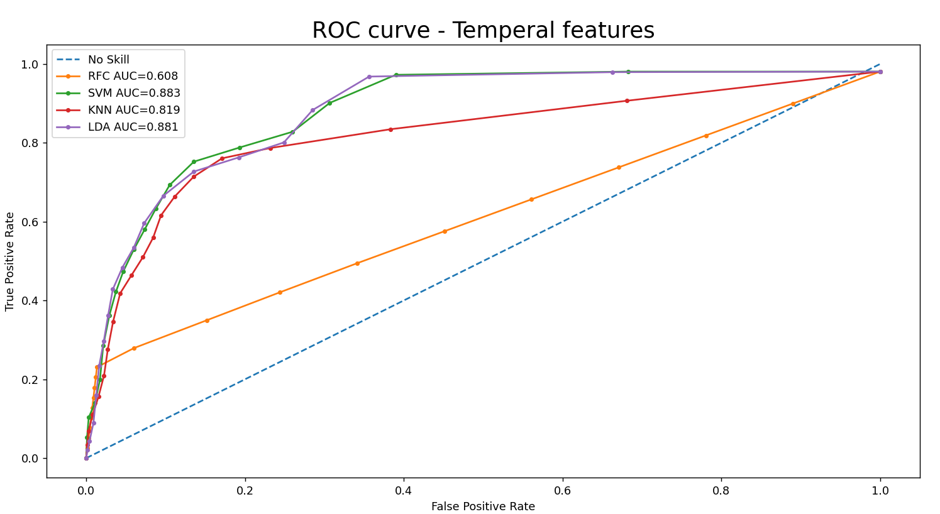
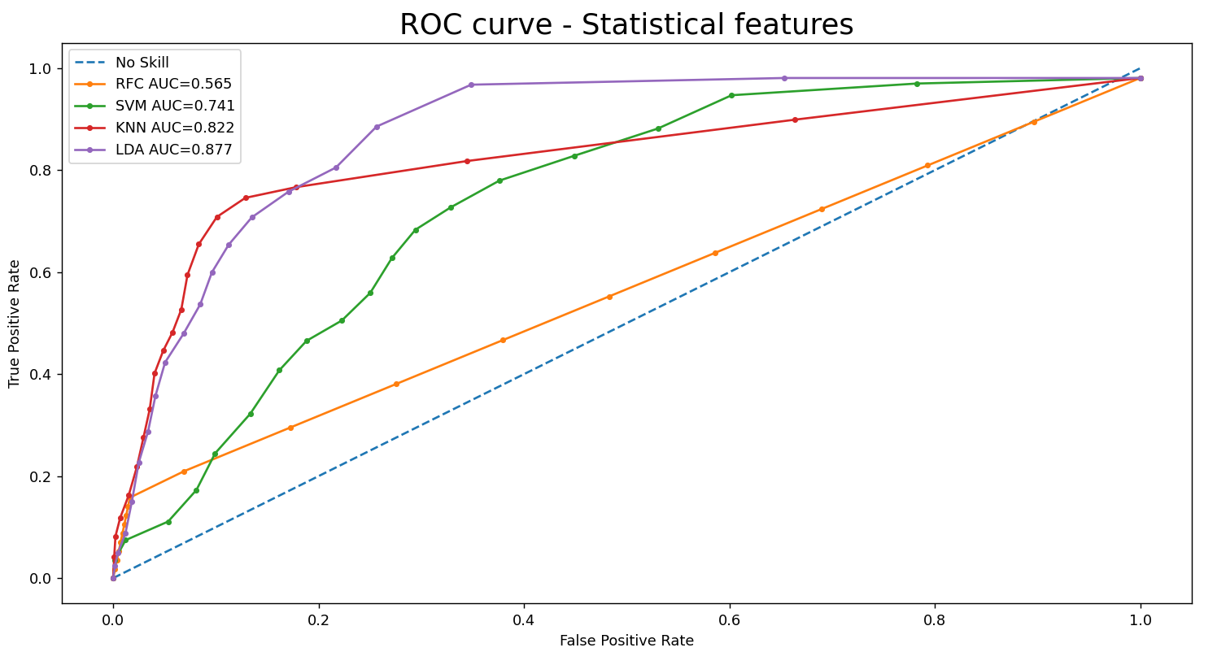
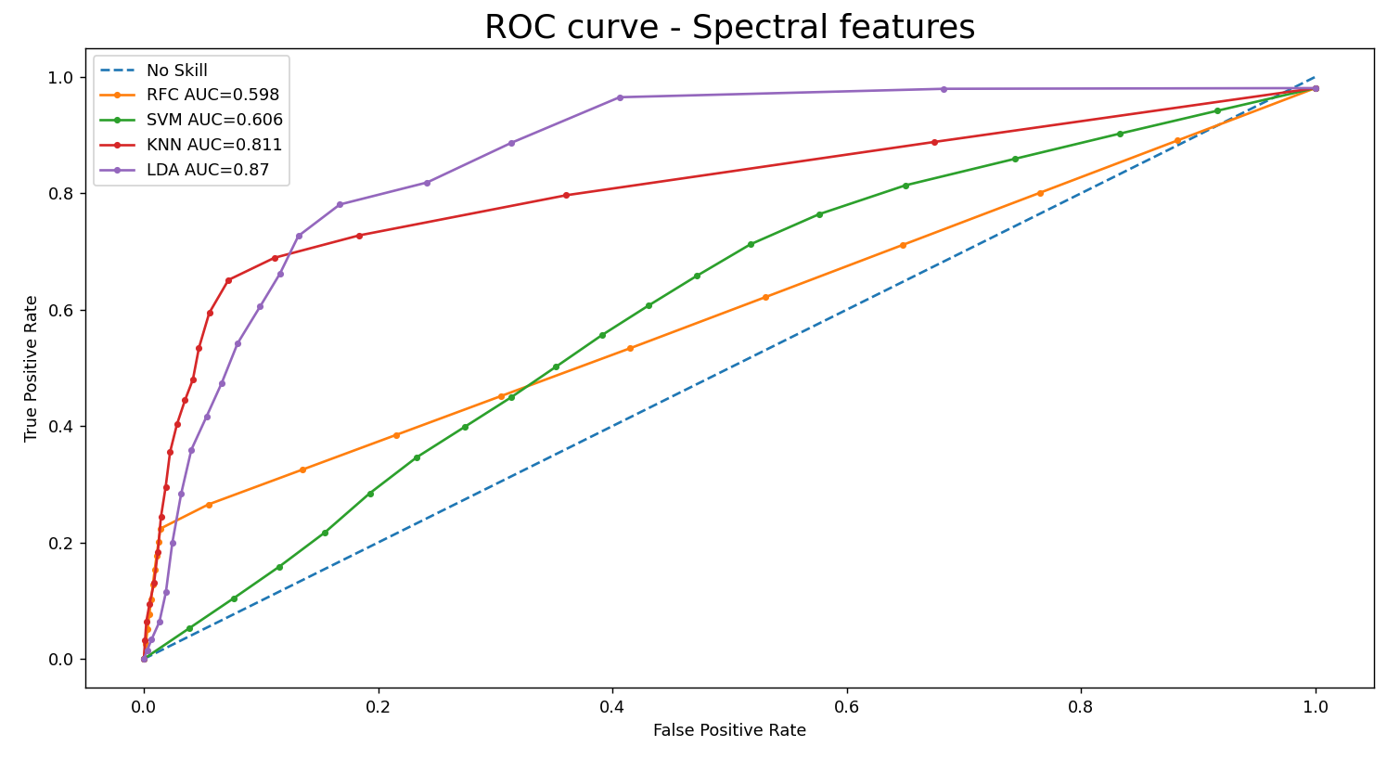
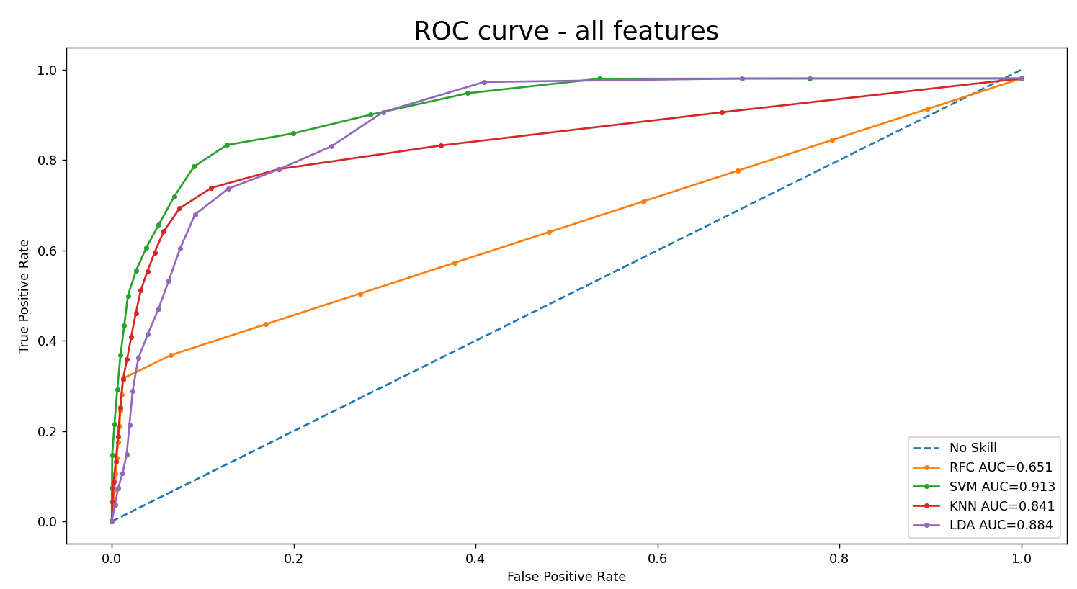
Results and Discussion

Slide 15
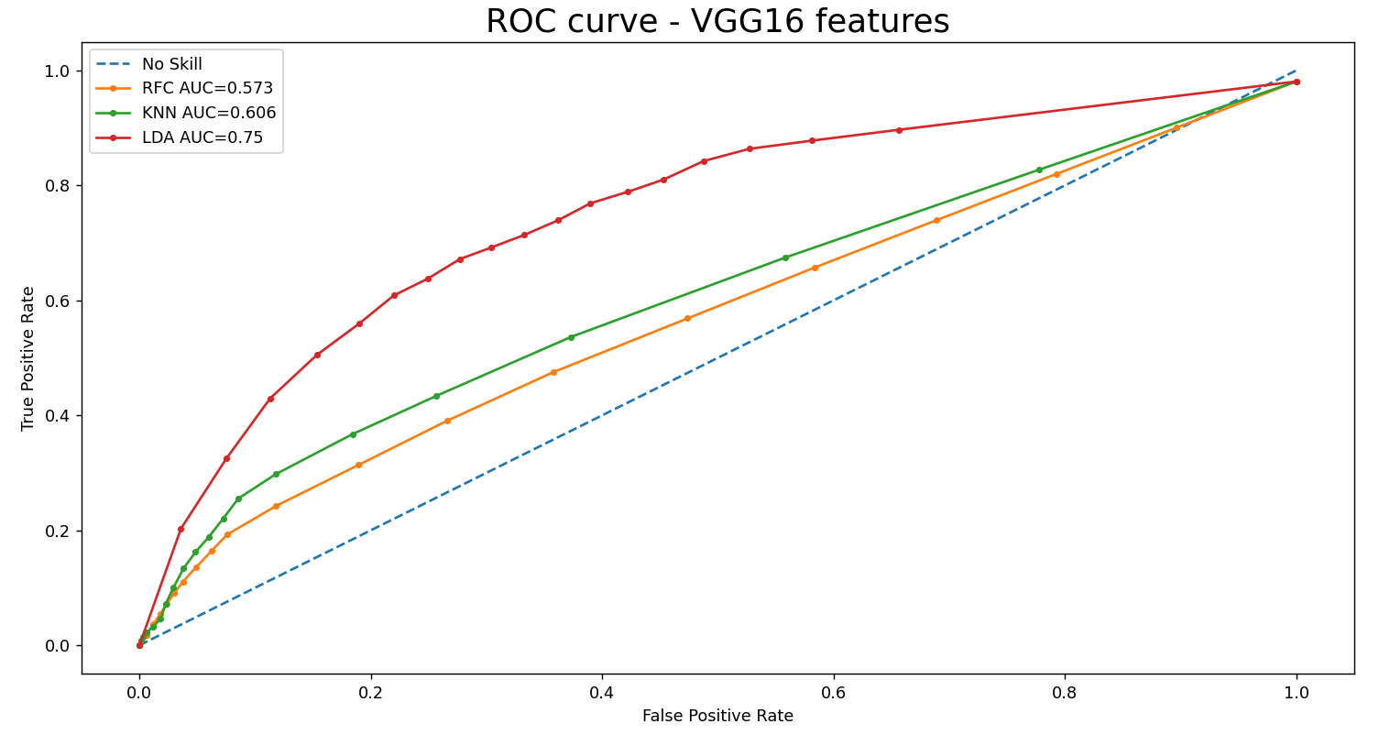
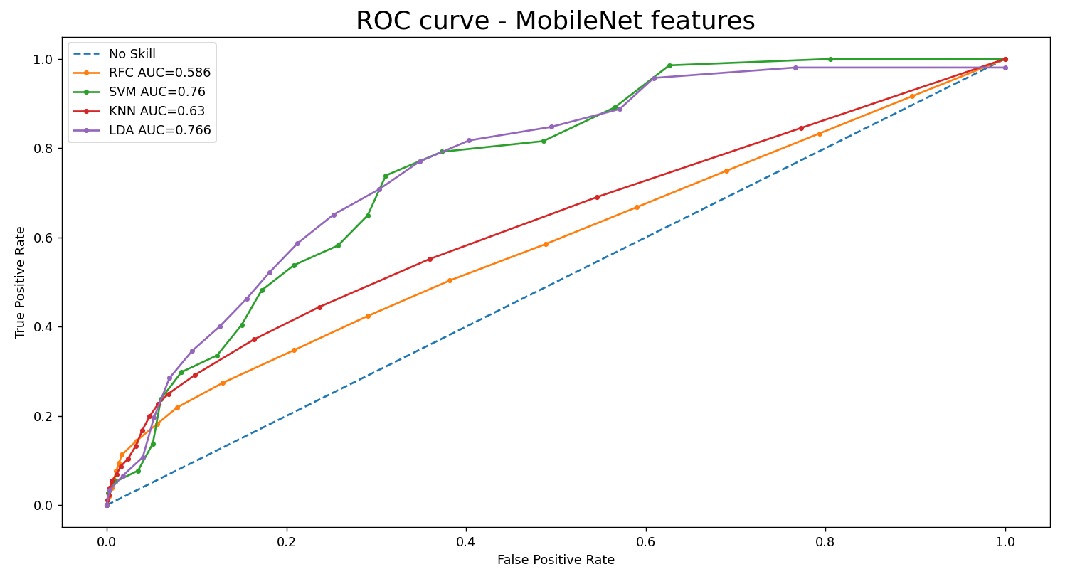
Results and Discussion

Slide 16
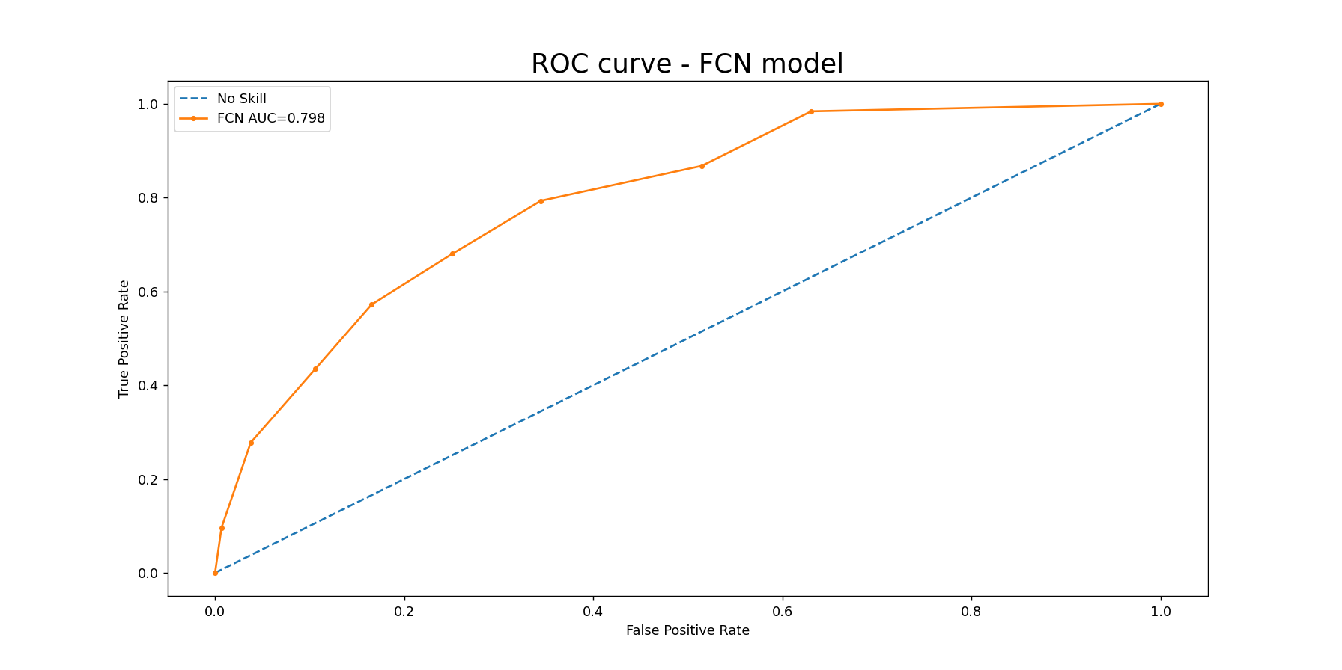
Results and Discussion

Slide 17
Results and Discussion-AUC
Conventional ML algorithms |  | LDA | SVM | KNN | RFC
 | Temporal Features | 0.881 | 0.883 | 0.819 | 0.608
 | Spectral Features | 0.870 | 0.811 | 0.606 | 0.598
 | Statistical Features | 0.877 | 0.822 | 0.741 | 0.565
 | All Features | 0.884 | 0.913 | 0.841 | 0.651
Transfer learning |  | LDA | SVM | KNN | RFC
 | MobileNet Features | 0.766 | 0.760 | 0.630 | 0.586
 | VGG16 Features | 0.750 | - | 0.606 | 0.573
End-to-end Method |  | FCN
 | MobileNet Features | 0.798

Slide 18
Results and Discussion- EER
Conventional ML algorithms |  | LDA | SVM | KNN | RFC
 | Temporal Features | 0.215 | 0.203 | 0.222 | 0.438
 | Spectral Features | 0.193 | 0.412 | 0.228 | 0.441
 | Statistical Features | 0.206 | 0.306 | 0.206 | 0.465
 | All Features | 0.202 | 0.147 | 0.202 | 0.402
Transfer learning |  | LDA | SVM | KNN | RFC
 | MobileNet Features | 0.298 | 0.286 | 0.404 | 0.452
 | VGG16 Features | 0.306 | - | 0.418 | 0.453
End-to-end Method |  | FCN
 | MobileNet Features | 0.285

Slide 19
Results and Discussion- ROC

Slide 20
Thank you
Question?

